Slide 1
Charts of the Week
04/11/22
Publication by Andy Cates, Haver Senior Economist

Slide 2
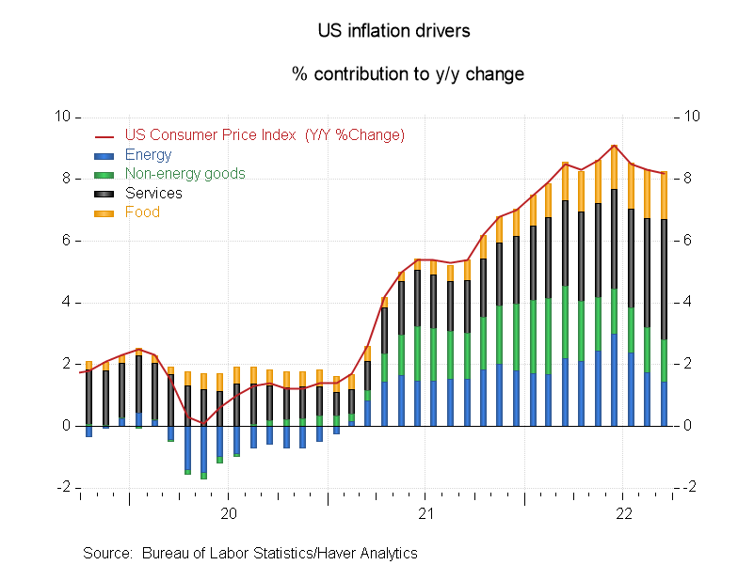
Chart 1: US Inflation Contributions
Series code for Haver clients:
Series 1: PCUY@USECON
PCUY@USECON [CPI-U: All Items, 1982-84=100 (Y/Y %Change)]
Series 2: (((RUEGM@USECON * YPCUSE@USECON) / 100) - ((YPCUSE@USECON * diff(RUEGM@USECON,12)
RUEGM@USECON [CPI-U: Relative Importance: Energy (Parts per 100)]
YPCUSE@USECON [CPI-U: Energy: 1982-84=100 (Y/Y %Chg)]
100
YPCUSE@USECON [CPI-U: Energy: 1982-84=100 (Y/Y %Chg)]
RUEGM@USECON [CPI-U: Relative Importance: Energy (Parts per 100)]
100
Series 3: (((YPCUSCFE@USECON * RUCXFDGM@USECON) / 100) - ((YPCUSCFE@USECON * diff(RUCXFDGM@
YPCUSCFE@USECON [CPI-U: Commodities Less Food and Energy Commodities: 1982-84=100 (Y/Y %Chg)]
RUCXFDGM@USECON [CPI-U: Relative Importance: Commodities Less Food & Energy (Parts per 100)]
100
YPCUSCFE@USECON [CPI-U: Commodities Less Food and Energy Commodities: 1982-84=100 (Y/Y %Chg)]
RUCXFDGM@USECON [CPI-U: Relative Importance: Commodities Less Food & Energy (Parts per 100)]
100
Series 4: (((YPCUSSLE@USECON * RUSXEGM@USECON) / 100) - ((YPCUSSLE@USECON * diff(RUSXEGM@US
YPCUSSLE@USECON [CPI-U: Services Less Energy Services: 1982-84=100 (Y/Y %Chg)]
RUSXEGM@USECON [CPI-U: Relative Importance: Services Less Energy Services (Parts per 100)]
100
YPCUSSLE@USECON [CPI-U: Services Less Energy Services: 1982-84=100 (Y/Y %Chg)]
RUSXEGM@USECON [CPI-U: Relative Importance: Services Less Energy Services (Parts per 100)]
100
Series 5: (((YPCUFO@USECON * RUFDM@USECON) / 100) - ((YPCUFO@USECON * diff(RUFDM@USECON,12)
YPCUFO@USECON [CPI-U: Food: 1982-84=100 (Y/Y %Chg)]
RUFDM@USECON [CPI-U: Relative Importance: Food (Parts per 100)]
100
YPCUFO@USECON [CPI-U: Food: 1982-84=100 (Y/Y %Chg)]
RUFDM@USECON [CPI-U: Relative Importance: Food (Parts per 100)]
100

Slide 3
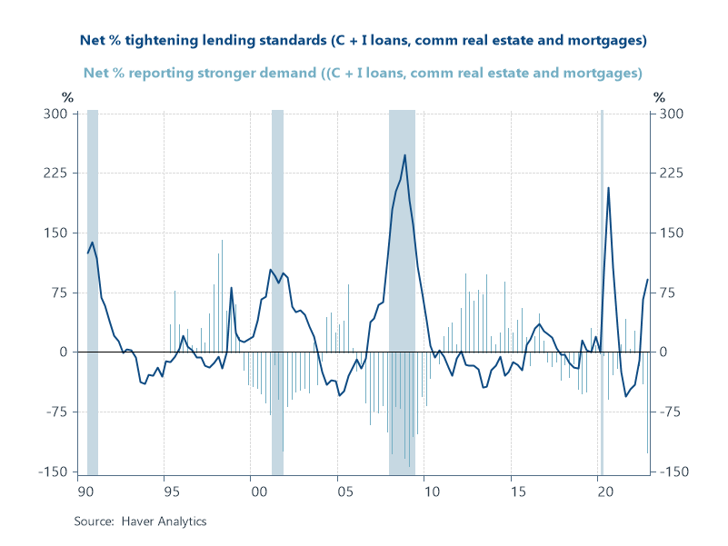
Chart 2: US Senior Loan Officer Survey – lending standards and demand
Series code for Haver clients:
Series 1: (((FDCNRH@SURVEYS + FDCREH@SURVEYS) + FDCIL@SURVEYS) / 3)
FDCNRH@SURVEYS [FRB Sr Loan Survey: Res Mortgages: Net Share, Banks w/ More Demand(Haver Est, %)]
FDCREH@SURVEYS [FRB Sr Loan Survey: CRE Loans: Net Share, Banks w/ More Demand (Haver Est, %)]
FDCIL@SURVEYS [FRB Sr Off Survey: Banks Rprtg Stronger Demand for C&I Loans/Lg Firms (%)]
3
Series 2: (((FTCNMH@SURVEYS + FTCREH@SURVEYS) + FTCIL@SURVEYS) / 3)
FTCNMH@SURVEYS [FRB Sr Loan Survey: Res Mortgages: Net Share, Banks Tightening (Haver Est, %)]
FTCREH@SURVEYS [FRB Sr Loan Survey: CRE Loans: Net Share, Banks Tightening (Haver Est, %)]
FTCIL@SURVEYS [FRB Sr Officers Survey: Banks Tightening C&I Loans to Large Firms (%)]
3

Slide 4
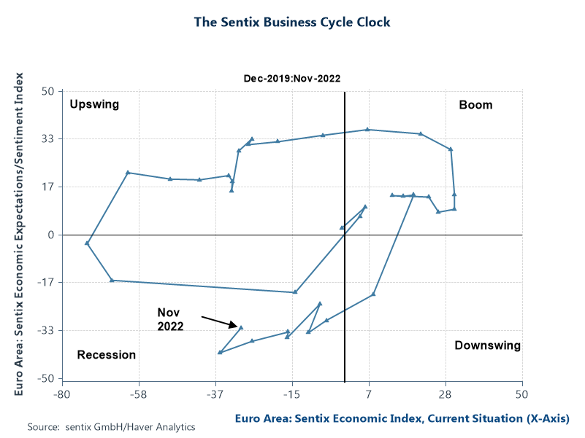
Chart 3: Euro area sentix survey and the business cycle clock
Series codes for Haver clients: Series 1: N023VSH0@EUDATA
N023VSH0@EUDATA [Euro Area: Sentix Economic Index, Current Situation (NSA, %Bal)]
Series 2: N023VSH6@EUDATA
N023VSH6@EUDATA [Euro Area: Sentix Economic Expectations/Sentiment Index (NSA, %Bal)]

Slide 5
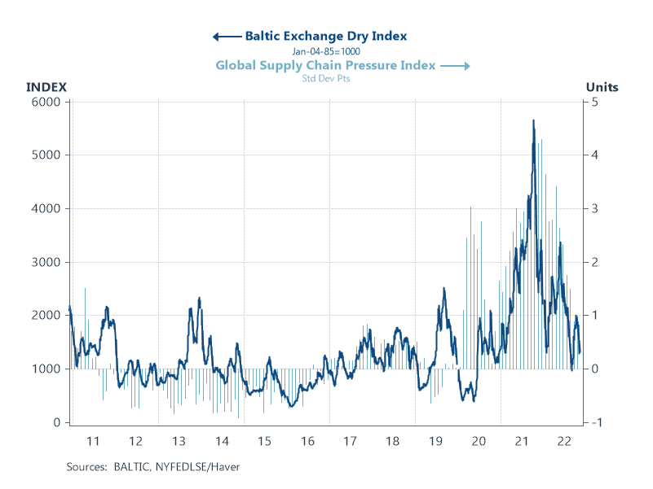
Chart 4: Baltic dry index versus the global supply chain pressure index
Series code for Haver clients:
Series 1: BDI@BALTIC
BDI@BALTIC [Baltic Exchange Dry Index (Jan-04-85=1000)]
Series 2: W1NGSCPI@TRANSPRT
W1NGSCPI@TRANSPRT [Global Supply Chain Pressure Index (Std Dev Pts)]

Slide 6
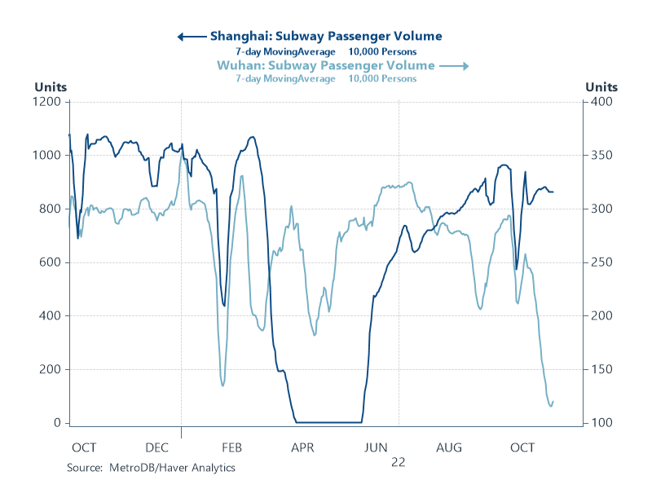
Chart 5: Subway Passenger Volumes in China
Series codes for Haver clients:
Series 1: movv(CNDSHPS@TRANSPRT,7)
CNDSHPS@TRANSPRT [Shanghai: Subway Passenger Volume (10,000 Persons)]
Series 2: movv(CNDWUPS@TRANSPRT,7)
CNDWUPS@TRANSPRT [Wuhan: Subway Passenger Volume (10,000 Persons)]

Slide 7
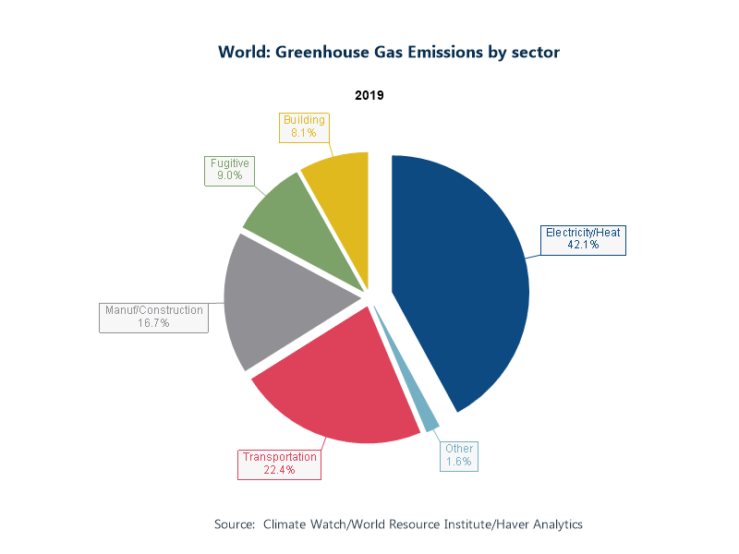
Chart 6: Global greenhouse gas emissions by sector
Series code for Haver clients:
Series 1: C001BGCG@ESG
C001BGCG@ESG [World: Greenhouse Gas Emissions from Electricity/Heat (Mil.Metric Tons CO2e)]
Series 2: C001BGOG@ESG
C001BGOG@ESG [World: Greenhouse Gas Emissions from Other Fuel Combustion(Mil.Metric Tons CO2e)]
Series 3: C001BGRG@ESG
C001BGRG@ESG [World: Greenhouse Gas Emissions from Transportation (Mil.Metric Tons CO2e)]
Series 4: C001BGMG@ESG
C001BGMG@ESG [World: GHG Emissions from Manufacturing/Construction(Mil.Met.Ton CO2e)]
Series 5: C001BGFG@ESG
C001BGFG@ESG [World: Fugitive Greenhouse Gas Emissions (Mil.Metric Tons CO2e)]
Series 6: C001BGBG@ESG
C001BGBG@ESG [World: Greenhouse Gas Emissions from Building (Mil.Metric Tons CO2e)]

Slide 8
For more information about these data, included data codes and DLXVG3 chart files, please email sales@haver.com and mention Charts of the Week.
Alternatively, visit https://haverproducts.com/products/ to browse our databases.

